Slide 1




TechHub
presents
BRAIN STROKE ANALYSIS
- Bipul Senapati
Senior Software Engineer

Slide 2
Brain Stroke?
When the blood supply to the brain is interrupted suddenly, it results in a stroke. The reason for the cessation of blood can be due to a blocked or burst blood vessel.
A stroke is a debilitating condition that can negatively alter a person’s life, especially if left untreated. Early diagnosis of a stroke can greatly reduce the stroke patient’s chances of living with a disability.
Magnetic resonance imaging (MRI) are one of the best diagnostic tests for strokes. MRI’s are excellent at detecting even tiny abnormalities, which are often too small to be clearly seen in a CT scan.
India Suffers one stroke death in every 4 minutes, says AIIMS neuro expert

Slide 3
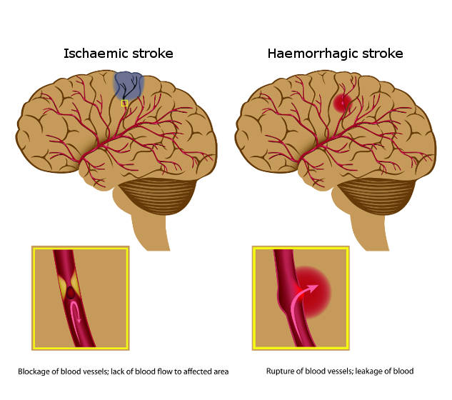
Types & Symptoms
Sudden numbness or weakness in the face, arm, or leg, especially on one side of the body.
Sudden confusion, trouble speaking, or difficulty understanding speech.
Sudden trouble seeing in one or both eyes.
Sudden trouble walking, dizziness, loss of balance, or lack of coordination.
Impairment or loss of consciousness
Courtesy : https://main.mohfw.gov.in/sites/default/files/Guidelines%20for%20Prevention%20and%20Managment%20of%20Stroke.pdf

Slide 4

Major risk factors of stroke
Modifiable Risk Factors:
Hypertension
Diabetes Mellitus
Dyslipidemia
Obesity and Body fat distribution.
Physical inactivity
Tobacco use
Structured cardiac diseases such as rheumatic valve disease
Atrial fibrillation
Sickle cell disease
Carotid stenosis
Excessive Alcohol consumption
Unhealthy diet and nutrition
Less – Modifiable Risk Factors:
Migraine
Metabolic Syndrome
Drug Abuse
Obstructive Sleep apnea
Hyperhomocysteinemia
Hypercoagulability
Elevated Lp (a)
Inflammation and Infection
Non-modifiable risk factors:
Genetic factors
Increasing age
Low birth weight
Race/ethnicity
Low socio-economic status
Male gender

Slide 5
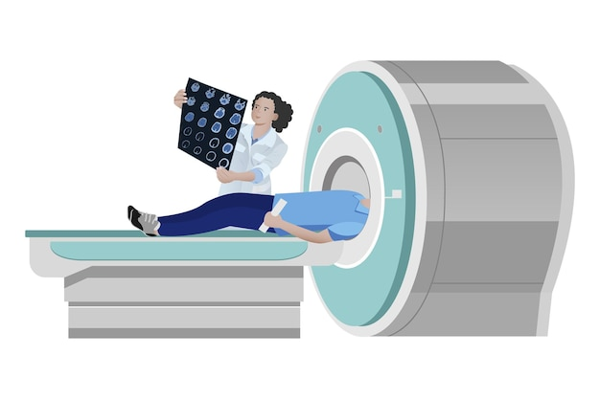
Agenda
Overview of Brain Stroke & significance in healthcare
Defining goals and objectives of stroke analysis model.
Approach to Stroke analysis model
Discussion on choice of neural network architecture and layers
Evaluation metrics used for model performance for clinical practice.
Exploring potential applications of deep learning in healthcare beyond stroke analysis

Slide 6
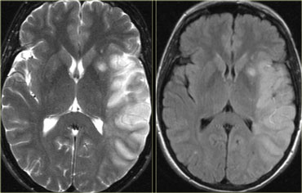
Focused Problem
The task at hand for the data scientist is to develop a deep learning model based on Neural Networks to classify brain stroke images in to normal and stroke categories.
The aim is to build an accurate and efficient model that can diagnose and distinguish between normal and stroke images with high precision, aiding healthcare professionals the timely detection and treatment of brain Stroke patients.

Slide 7
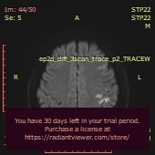
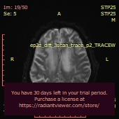
Exploratory Data Analysis
Training Samples
POSITIVE LABEL
(Stroke)
NEGATIVE LABEL
(Normal)

Slide 8
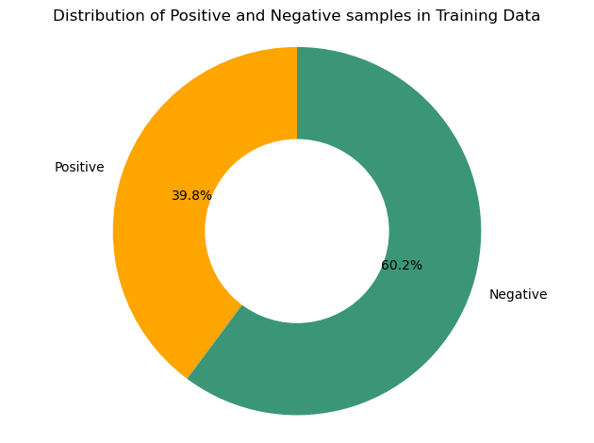
Exploring Training Data
Positives are 39.8% and Negatives are 60.2% in the training data.
Data is slightly Imbalanced.

Slide 9
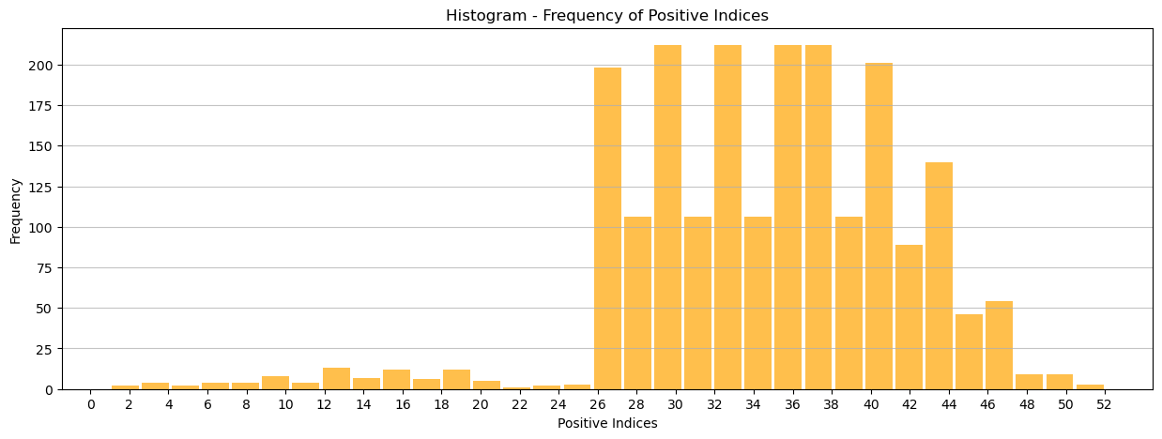
Based on the presented histogram, it can be inferred that there is a notable increase in the frequency of positive values within the range of 26 to 44.

Slide 10
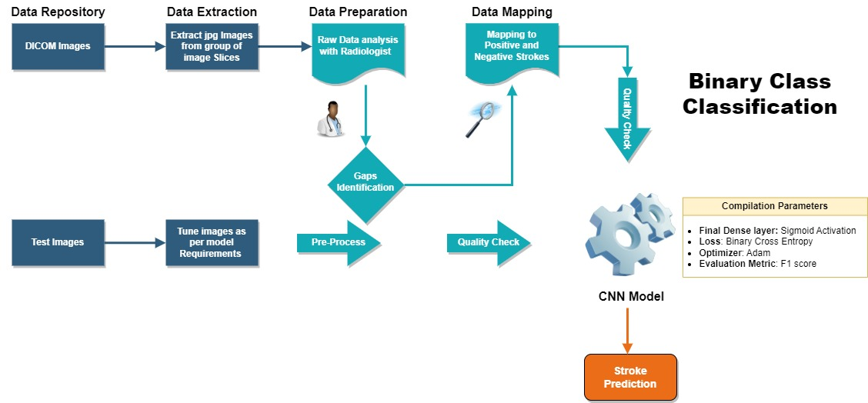
High Level Model Architecture

Slide 11
Methodology
Data Repository :
Obtaining the data was the most important first step for starting this project.
The DICOM file was converted into .JPG format for training.
The aim was to segregate.JPG images into positive and negative brain strokes based on the labels given by the radiologist in .csv format.
It was also necessary for the brain strokes to be labelled because we do not have the medical expertise to conclude the type of stroke a patient is suffering from. The data of the patients was labeled by the radiologist as positive and negative.
Data Segregation/Mapping :
The patient ID folders were subject to segregation of their respective images into positive and negative categories, based on the labels specified in the accompanying Excel file.
Data Preprocessing
In order to perform preprocessing on the provided brain scans, the utilization of two key software libraries, namely OpenCV and NumPy, was imperative.

Slide 12
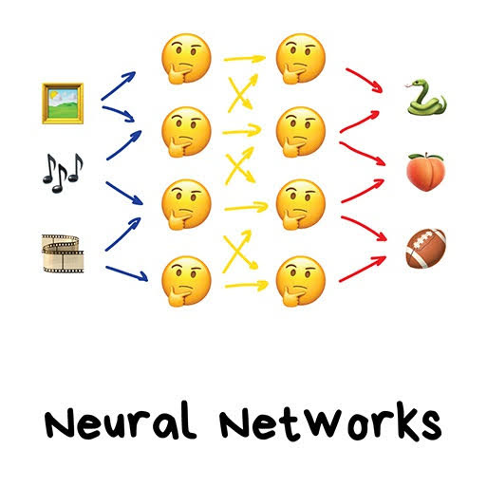
Neural Network
Give your neural net a snake it will be able to detect snake for rest of the life.

Slide 13
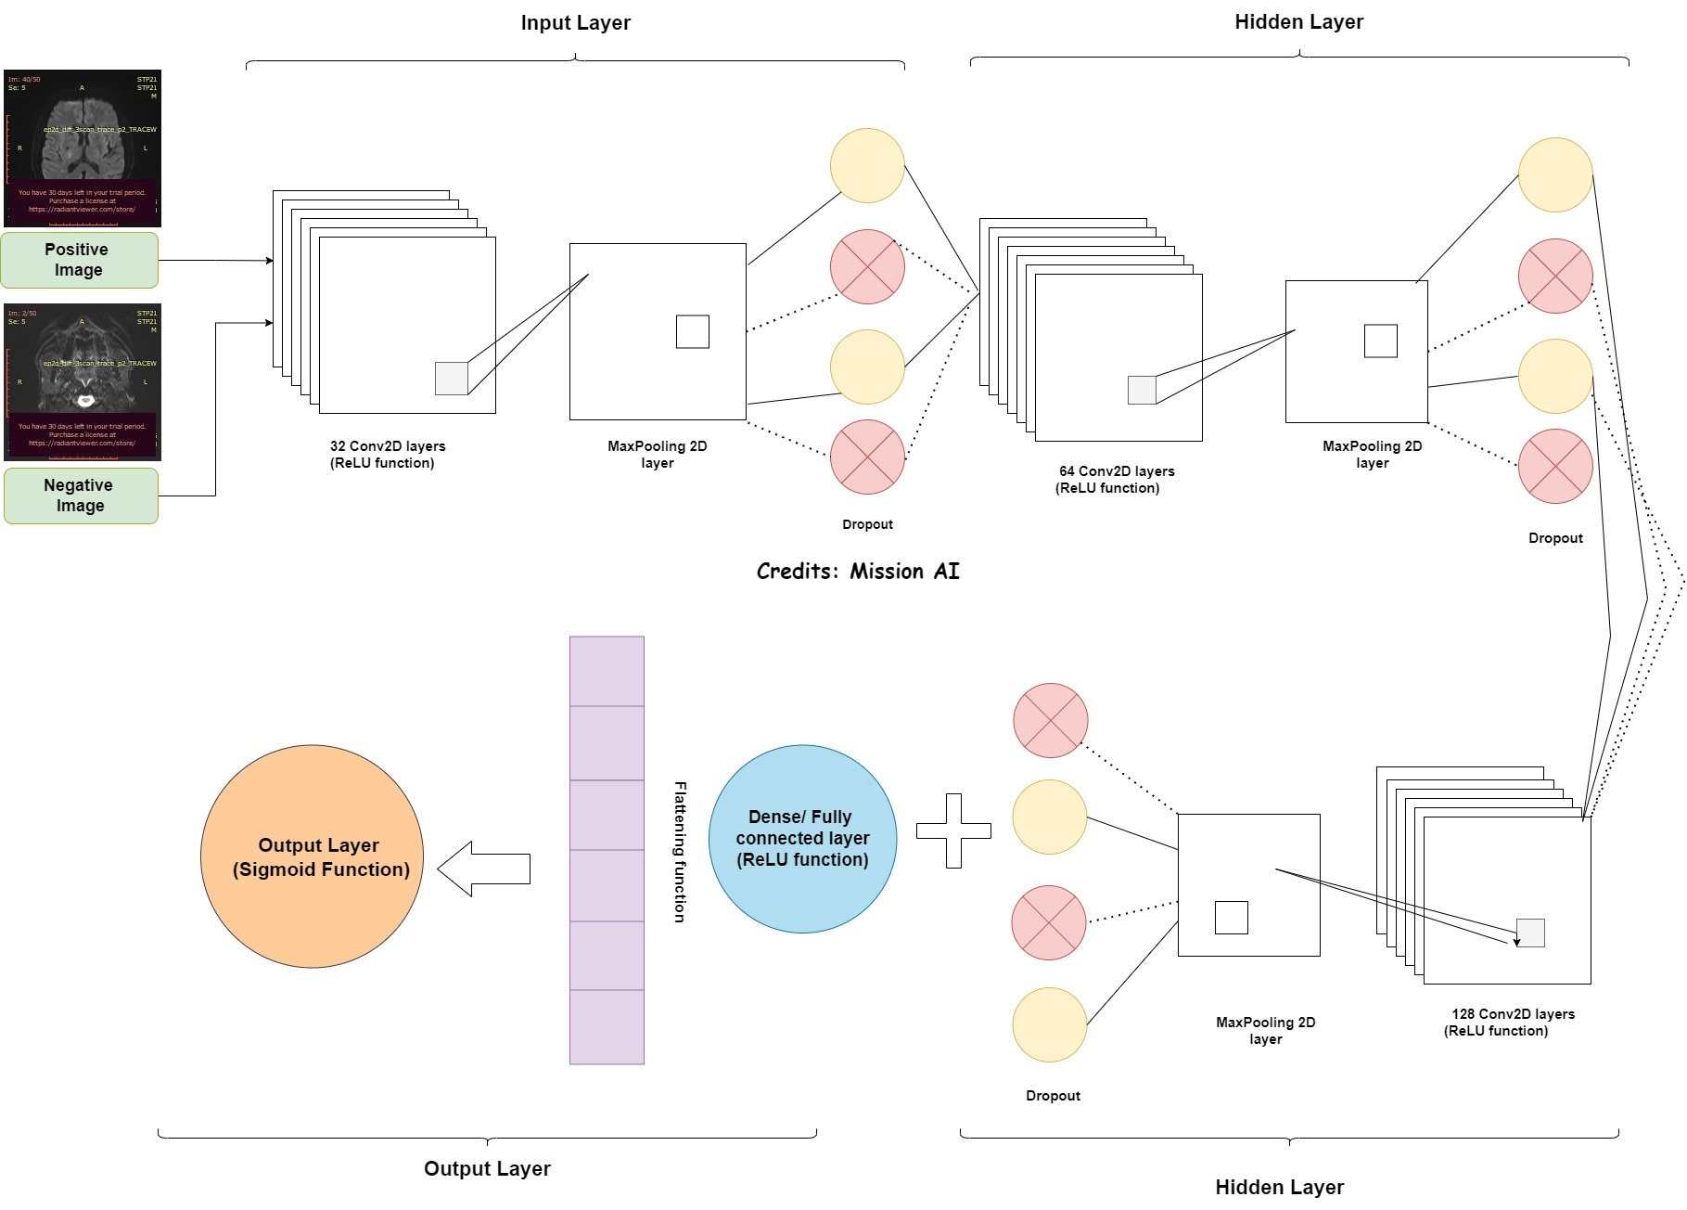

Slide 14
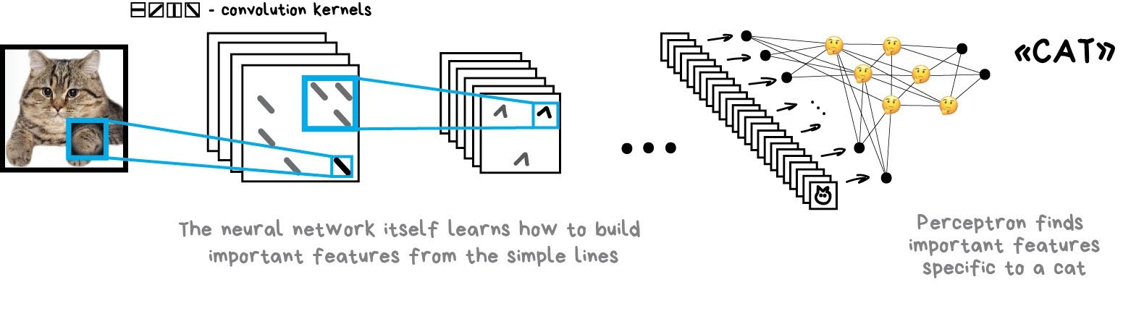
Convolutional Neural Network (CNN)
This model is now responsible to detect CAT for rest of its life.

Slide 15
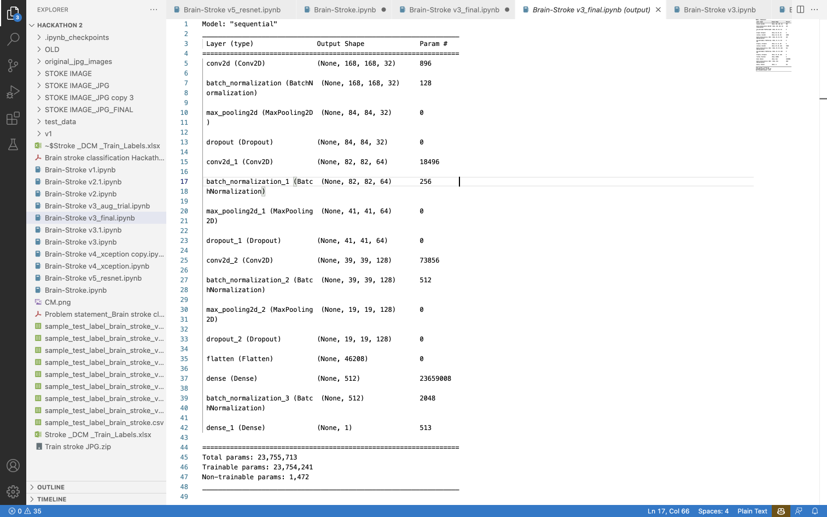
Model Specification of CNN model

Slide 16

Results and Analysis

Slide 17
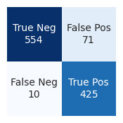
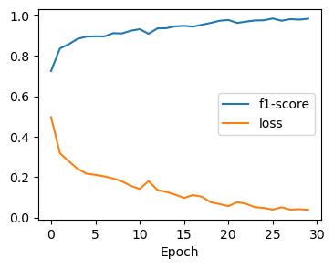
Analysis of Different Models
Convolutional Neural Network model
Confusion Matrix
F1-score & Loss vs. Epoch

Slide 18
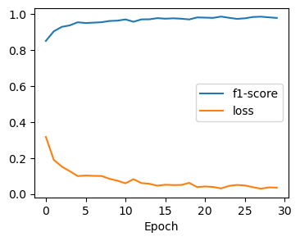
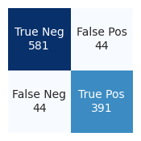
Analysis of Different Models
Transfer learning – VGG16
Confusion Matrix
F1-score & Loss vs. Epoch

Slide 19
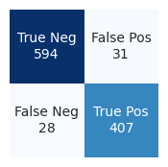
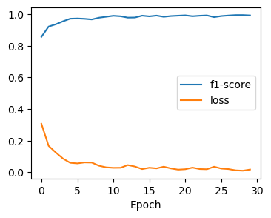
Analysis of Different Models
Transfer learning - ResNet
Confusion Matrix
F1-score & Loss vs. Epoch

Slide 20

Doubt!
Confusion Matrix??
F1 Score???
True Positive ?
False Negative?

Slide 21
Confusion Matrix
Normal
Stroke
A confusion matrix consists of four elements: true positive (TP), true negative (TN), false positive (FP), and false negative (FN).
True Positive (TP): The model correctly predicted that the image is a stroke image.
True Negative (TN): The model correctly predicted that the image is a normal image.
False Positive (FP): The model predicted the image as a stroke image but it is actually a normal image.
False Negative (FN): The model predicted the image as a normal image but it is actually a stroke image.
Predicted | Confusion Matrix
Normal | FN | TN
Stroke | TP | FP

Slide 22
Model’s Performance
Even though VGG16 gave the best f1- score (validation) CNN model gave the better test predictions.
Calculation are done after hyperparameter tuning, when the final form of the classifier was decided on simple brain MRI DICOM Images
.
If we could have more accurate data sets like gender, age, patient history, then we could improvise our model with more accuracy keeping eye on Modifiable & Non-Modifiable risk factors of Brain Stroke.
Model Version | F1-Score (Training) | Loss (Training) | F1-Score (Validation) | Loss (Validation)
CNN | 0.97 | 12.92% | 0.91 | 26.4%
VGG16 | 0.98 | 3.9% | 0.94 | 19.65%
ResNet50 | 0.99 | 0.93% | 0.93 | 26.4%

Slide 23
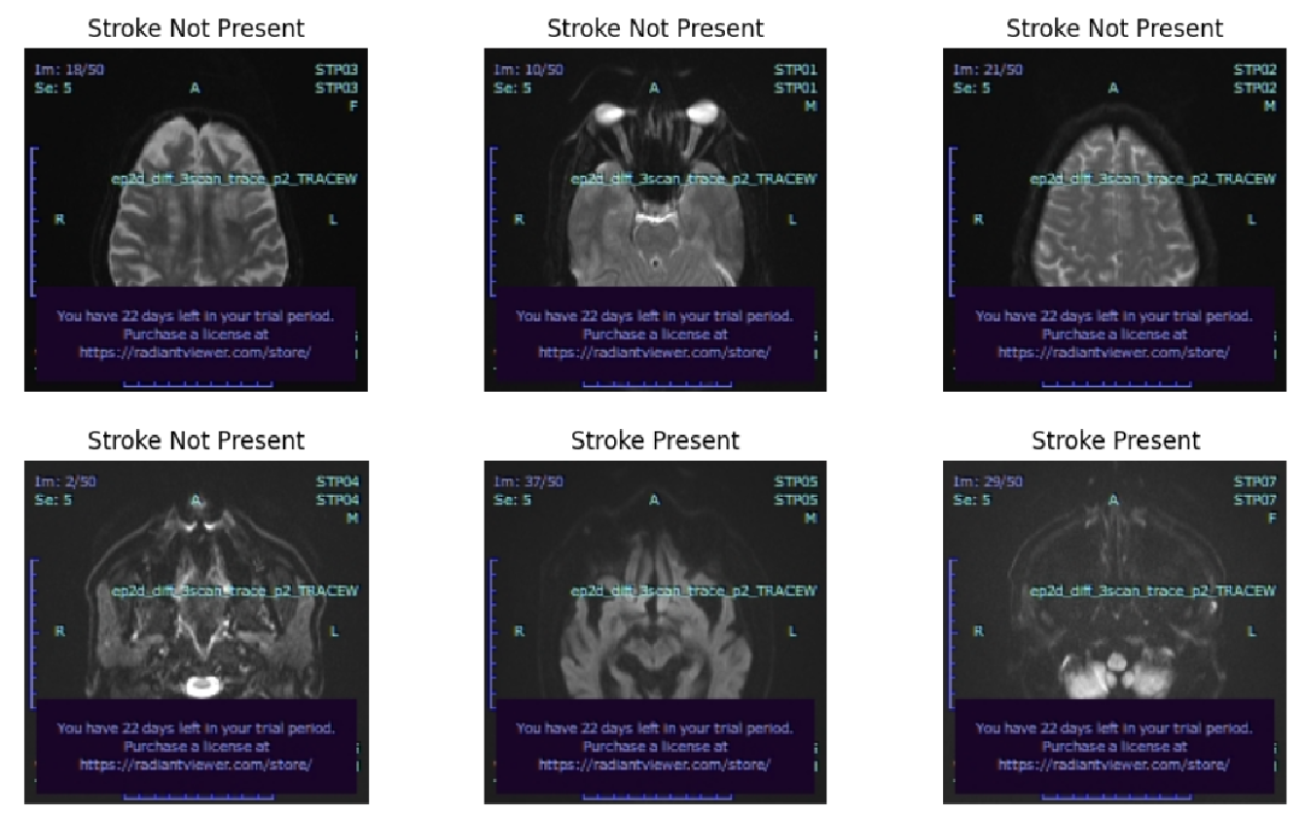
Random Test Images for Validation

Slide 24
Why F1 Score why not Accuracy Score?
Due to Imbalanced Datasets.
In imbalanced datasets, a high accuracy score can be achieved even if the model does not perform well on the minority class. For example, if a model simply classifies all samples as the majority class, it can still achieve high accuracy despite its inability to correctly classify the minority class.
The F1 score is more sensitive to the performance of the model on both classes, as it considers both false positives and false negatives. This makes it a more reliable metric for assessing the model's performance in imbalanced scenarios.
Taking the confusion matrix into account , several performance metrics can be calculated. For example:
Accuracy = (TP + TN) / (TP + TN + FP + FN)
Precision = TP / (TP + FP)
Recall = TP / (TP + FN)
F1 Score = 2 * (Precision * Recall) / (Precision + Recall)

Slide 25
Conclusion
The significance of reducing false negatives in medical-related models cannot be overstated. Inaccurate predictions in medical diagnostics can lead to serious consequences. False negatives, cases where a model incorrectly predicts a negative outcome when the true outcome is positive, are especially problematic. It is, therefore, essential for data scientists working with medical-based datasets to minimize false negatives in their models.
Deep learning techniques can play a significant role in Brain Stroke analysis. By implementing such models in remote villages through mobile or web apps, where junior radiologists can verify scan results, both the patient and the hospitals can reduce the cost of each scan. This is particularly important in areas where experienced radiologists and doctors may not be readily available
Moreover, this model can be implemented in real-time magnetic resonance imaging (MRI) machines. The radiologist scanning the brain MRI can take image slices of affected areas rather than the entire head. This would provide more precise and efficient results, leading to better patient outcomes

Slide 26
Future Scope in HealthCare with DL
Lungs Cancer Detection
Bone age Detection.
Doctor’s Prescription handwriting.
Heart failure Prediction.

Slide 27
Thank You So Much.
bipul.senapati@happiestminds.com
8895331388

